Slide 1


Is B2B Failing
At Digital Transformation?
The State Of Digital Transformation In B2B
By Taylor Wray & Nik Werk

Slide 2
Is B2B Customer Experience In Decline?
Percent of companies evaluating their performance as “strong” across the 6 pillars of customer experience
This information is confidential and property of B2B International. It is not to be shared with any third-parties without B2B International’s prior written consent.

Slide 3
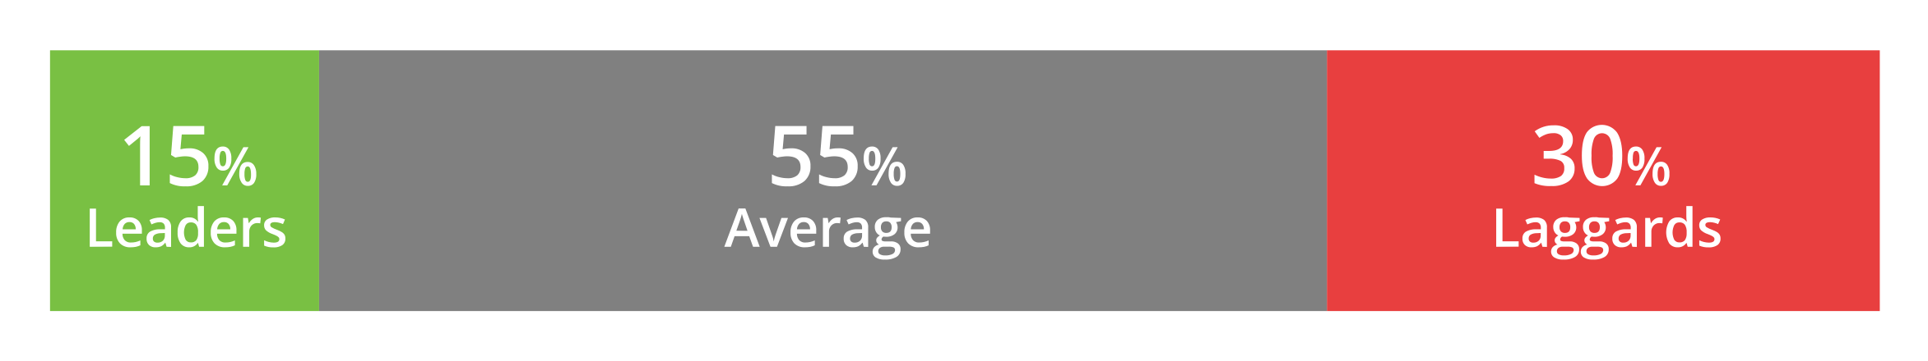
Few B2B Brands Deliver An Excellent Customer Experience
How many B2B brands are leaders in CX?
that deliver strong performance in
5-6 key pillars
performers that deliver strong performance in
1-4 key pillars
that deliver strong performance in
0 key pillars

Slide 4
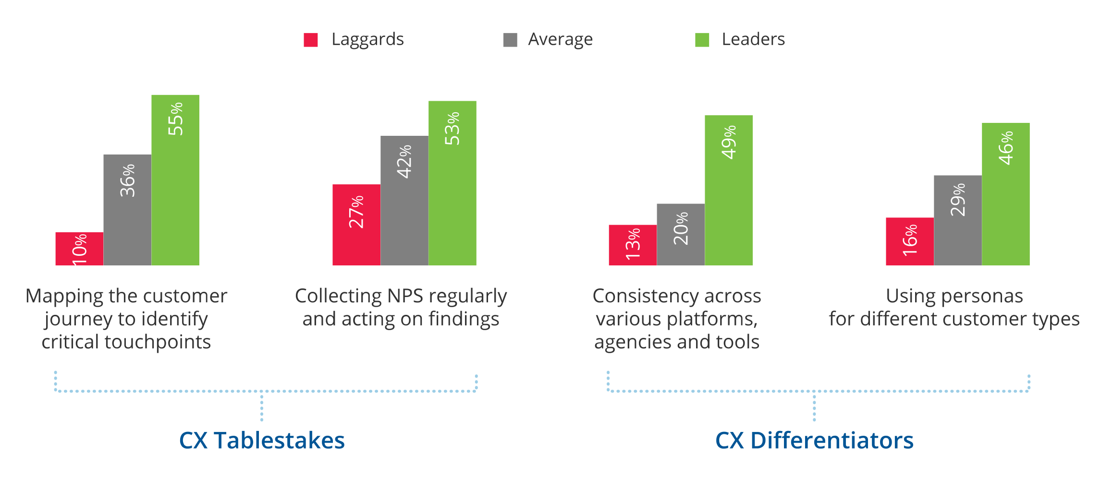
What B2B Customer Experience Leaders Are Doing Right
Percent of companies that are strong at the following practices:

Slide 5

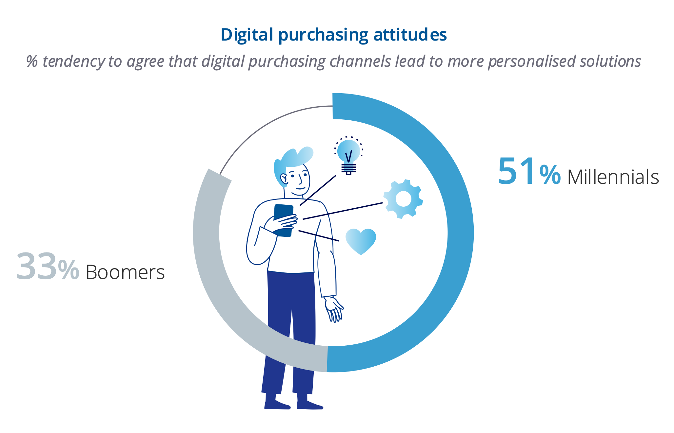

Millennials Are Reshaping B2B As Both Purchase and Strategy Decision Makers

Slide 6
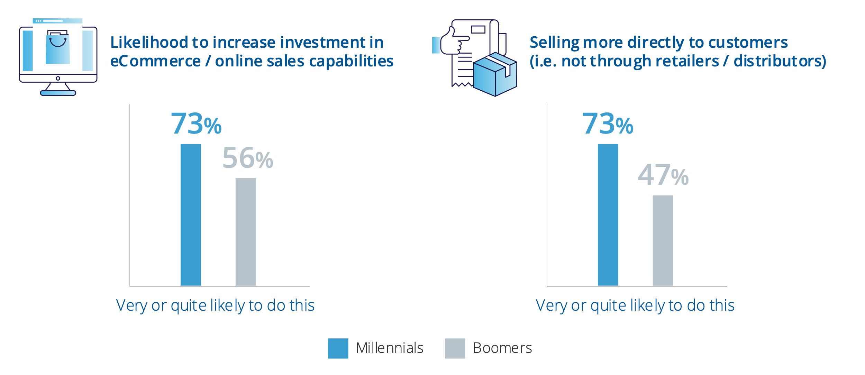
As Strategic Decision Makers, Millennials Are Particularly Interested In Direct Digital Channels
Millennials more likely to increase ecommerce & cut out the middle man

Slide 7
Most B2B Firms Have Accelerated Their Digital Transformation

Slide 8
Accelerating Digital Transformation Drives Short-Term Resilience

Slide 9
A Formal Digital Transformation Strategy Drives Long-Term Growth
49%
41%
have a formal roadmap for future digital transformation projects
have a dedicated budget for digital transformation projects
5-Year Business Growth Expectations
5-Year Business Growth Expectations

Slide 10
How Are B2B Firms Planning To Invest In Digital Transformation?
74%
68%
68%
60%
Improving the data and insights on customers and markets to anticipate future needs | e-commerce / online sales capabilities | new systems to help serve customers better (e.g. CRM, ERP) | automation, self-serve machines, robots

Slide 11





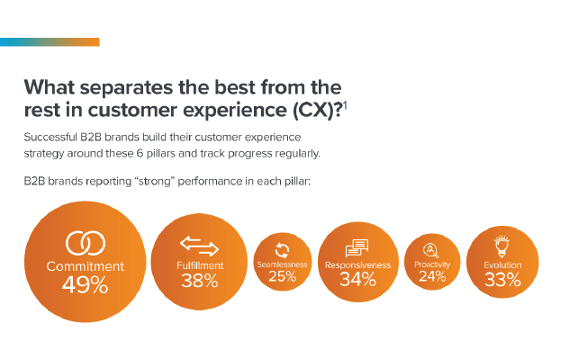
Digital Transformation In B2B …
… is key to CX excellence
… is often based on customer insight
… drives short-term resilience and long-term confidence
… requires a standalone strategy (and budget)
… is overdue

